Slide 1
L1B English Language & Linguistics
Witnesses for Early Modern English (EModE): the material turn in philology

Slide 2
What is the material turn?
A powerful trend in both humanities and social sciences
‘ … the importance of artifacts, natural forces, and material regimes to social practices and systems of power …’ (Mukerji 2015)

Slide 3
‘The material turn in philology’
... a paradigm shift that highlights the importance of the material context of the book for historical linguistics and textual scholarship ... philologists are now increasingly seen to include non-textual or supra-textual features of the physical book (artefact) as contextual variables in their analyses ... In doing so, they are informed by research in codicology and palaeography to scrutinize the physical structure, handwriting, layout, decoration and provenance of manuscripts (Drout and Kleinman 2010: section 8).
… materiality is an essential semiotic dimension of all texts; it plays an essential role for the reader’s reception of the text (Andersson 2014: 11).

Slide 4
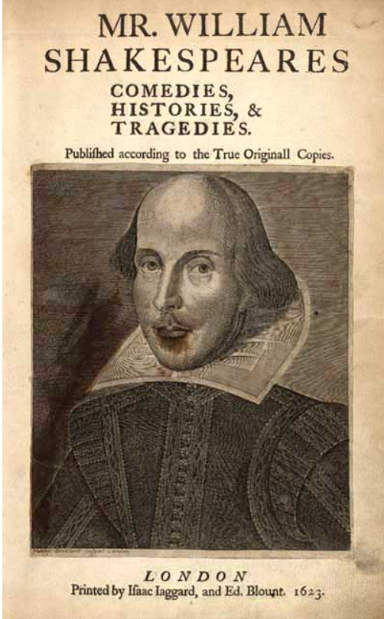
Glasgow, University Library, SpColl BD8-b.1

Slide 5
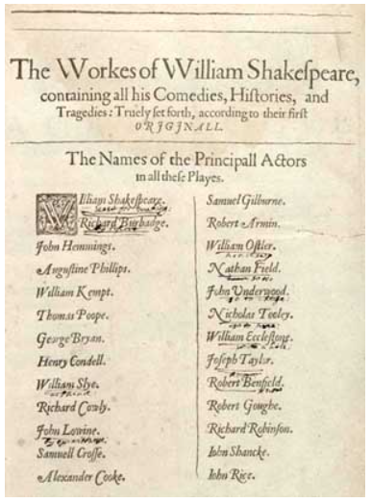

Slide 6
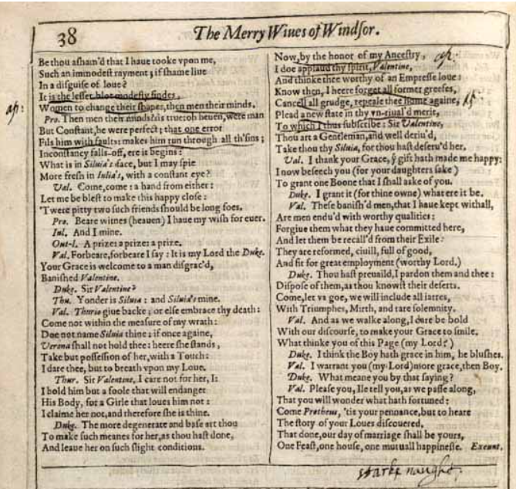
(Actually The Two Gentlemen of Verona ..)

Slide 7
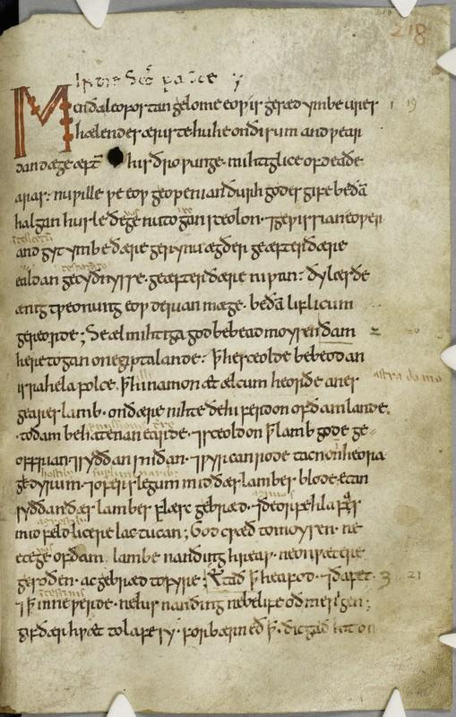
Cambridge, Corpus Christi College MS 198, fol 218r

Slide 8
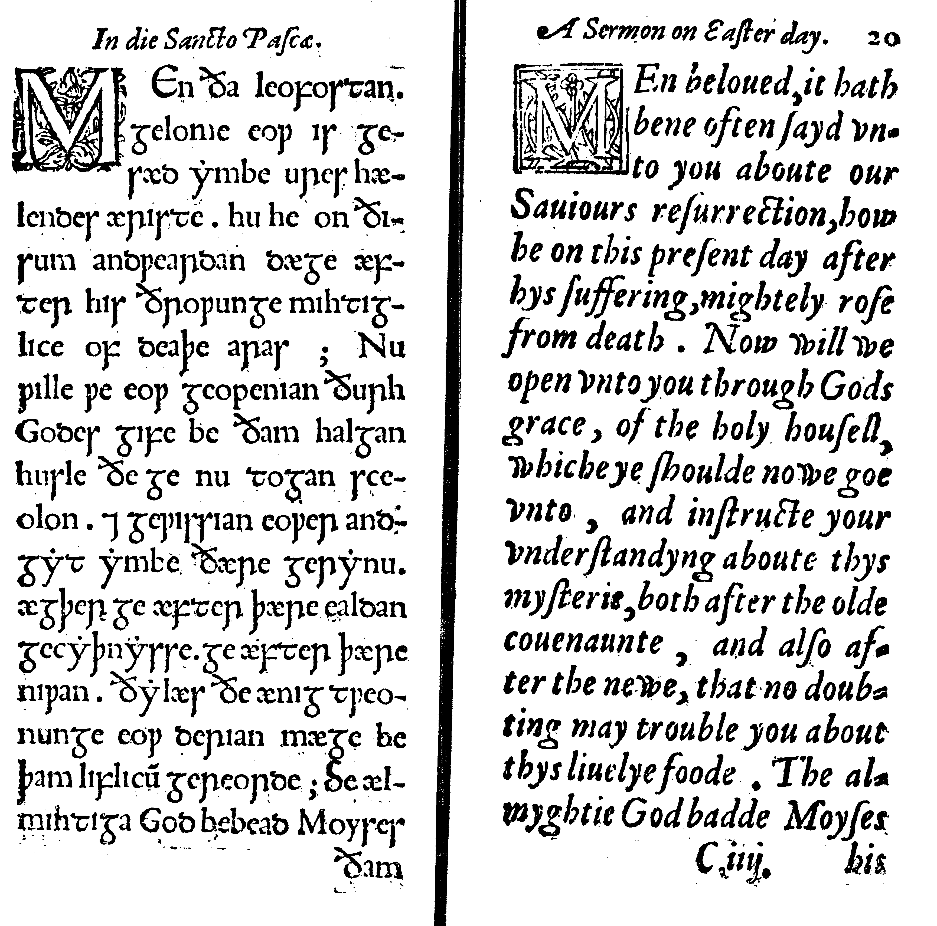
A testimonie of antiquitie (London: Day, 1566)

Slide 9
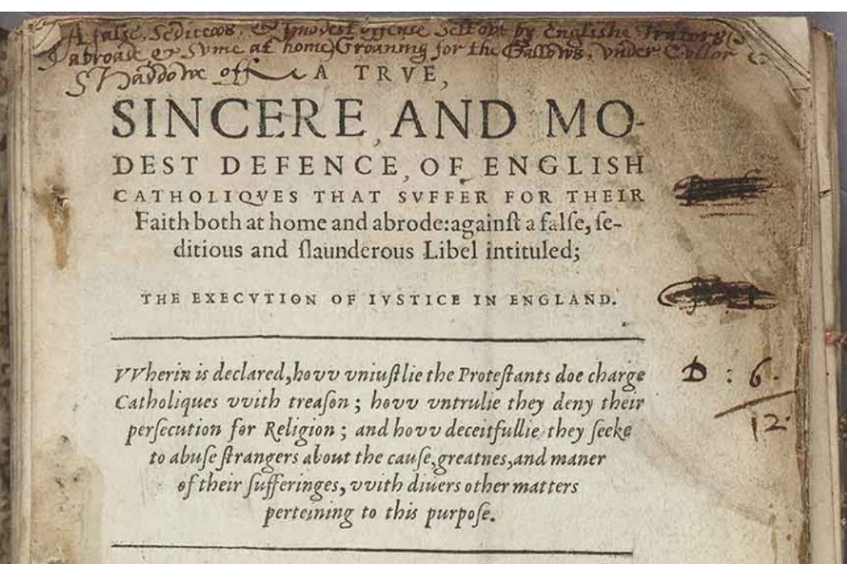

Slide 10
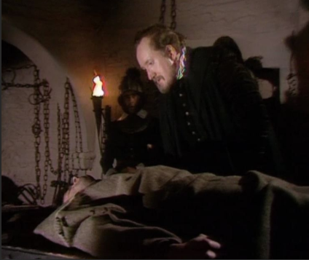
Richard Topcliffe (1531-1604)

Slide 11
Thanks!
Jeremy.Smith@glasgow.ac.uk

